Slide 1
CSCI2100C Lab 2
Prepared by:
Lo Chun Hei

Slide 2
Reminders
Please remember your password for the online judge
Please start your assignment early
And report any issues as early as possible. Some issues regarding the registration of the OJ were reported not until some hours before the deadline. For such cases of failure of code submission, we may not grade your lab.
Penalty:
-10 marks/day pro rata for first two days after deadline
-10 marks/hour pro rata afterwards (so you get 0 marks if you submit 2 day 8 hours after the deadline)
Grading is based on the last submission
Write your own code
We will check your code
Suspected cases of plagiarism will be reported
Questions?

Slide 3
Agenda
Array
Linked List
Stack
Queue
Example Code Discussion
Overview of Lab 2 Problems

Slide 4
Agenda
Array
Linked List
Stack
Queue
Example Code Discussion
Overview of Lab 2 Problems

Slide 5
Array Properties
An array is a collection of items stored at contiguous memory locations
Array variable points to the first position of the array in memory
Random access (base address + offset (assumed to be constant-time))
We need to specify the size when we create the array
Fixed number of elements decided at the time of declaration
Insertion and Deletion is O(n)
Often accompanied by O(n) searching for position of insertion/deletion as well
int arr_a[4] = {12,13,15,17}; /* arr_a is an array of 4 integers */
int i = 2, j;
 | 12 | 13 | 15 | 17 | 2
0x7ffd636b4260 | 0x7ffd636b4264 | 0x7ffd636b4268 | 0x7ffd636b426c | 0x7ffd636b4270 | 0x7ffd636b4274 | 0x7ffd636b4278
j
arr_a
i

Slide 6
Agenda
Array
Linked List
Stack
Queue
Example Code Discussion
Overview of Lab 2 Problems

Slide 7
Linked List Properties
A linked list a collection of items that are linked using pointers
Stored not necessarily at contiguous memory locations:
A (doubly) linked list consists of one or more node objects, where each node stores:
The data to be stored
Pointers to the previous node
Pointer to the next node
A head node and a tail node is maintained
∅
(head)
12
13
15
17
(tail)
∅
0x7ffd636b4214 | 0x7ffd636b1224
0x7ffd636b4264 | 0x7ffd636b1234 | 0x7ffd636bbbbc | 0x7ffd636b4270

Slide 8
Linked List Properties
Only neighbouring nodes are accessible
Accessing a particular node is O(n)
Nodes can be created dynamically at runtime
Insertion and Deletion is O(1) (if position(address) of insertion/deletion is known)
Often accompanied by O(n) searching for position of insertion/deletion
Unrestricted number of nodes
∅
(head)
12
13
15
17
(tail)
∅
0x7ffd636b4214 | 0x7ffd636b1224
0x7ffd636b4264 | 0x7ffd636b1234 | 0x7ffd636bbbbc | 0x7ffd636b4270

Slide 9
Agenda
Array
Linked List
Stack
Queue
Example Code Discussion
Overview of Lab 2 Problems

Slide 10
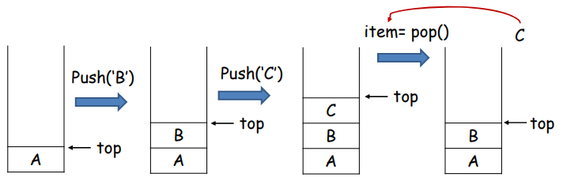
Stack Properties
A stack stores a set 𝑆 of elements that only allows two constrained updates (a.k.a. Last-In-First-Out (LIFO)):
Push(e): add a new element to 𝑆
Pop(): removes the most recently added element from 𝑆
Only the top element is accessible

Slide 11
Stack Implementation
Implementing with array:
Removal of element C is optional (why?)
Or can you actually remove an element from an array?
Change with some value that you never use; or use pointer to refer to another address
A | B | C
0x7ffd636b4260 | 0x7ffd636b4264 | 0x7ffd636b4268 | 0x7ffd636b426c | 0x7ffd636b4270 | 0x7ffd636b4274 | 0x7ffd636b4278
For the arrow representation, please note that top is an array index.
top
pop()
A | B | C
0x7ffd636b4260 | 0x7ffd636b4264 | 0x7ffd636b4268 | 0x7ffd636b426c | 0x7ffd636b4270 | 0x7ffd636b4274 | 0x7ffd636b4278
top

Slide 12
Stack Implementation
Implementing with linked list:
Removal of element C (from …) is a good practice (why?)
From memory, is no longer accessible to the element for better memory usage
For the arrow representation, please note that top is a pointer variable.
∅
(head)
A
B
C
(tail)
∅
0x7ffd636b4214 | 0x7ffd636b1224
0x7ffd636b4264 | 0x7ffd636b1234 | 0x7ffd636bbbbc
top
pop()
∅
(head)
A
B
(tail)
∅
0x7ffd636b4214 | 0x7ffd636b1224
0x7ffd636b4264 | 0x7ffd636b1234 | 0x7ffd636bbbbc
top

Slide 13
Stack Implementation
For both array and linked list implementation:
Push and pop operation requires only O(1) running cost
Array implementation
More efficient in terms of memory
linked lists requires additional storage for next and previous referencing elements.
Linked list implementation
No constraint on the capacity
Better utilized memory
Array uses fixed size of memory while linked list consumes memory that is proportional to the number of elements in the stack

Slide 14
Agenda
Array
Linked List
Stack
Queue
Example Code Discussion
Overview of Lab 2 Problems

Slide 15
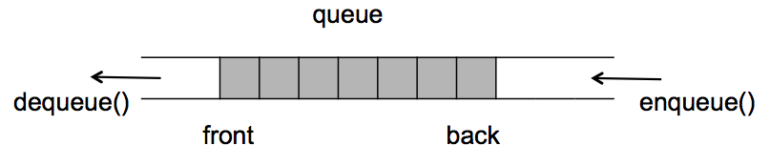
Queue Properties
A queue stores a set 𝑆 of elements that only allows two constrained updates (a.k.a. First-In-First-Out (FIFO)):
Enqueue(e): insert a new element 𝑒 into 𝑆
Dequeue: remove the least recently inserted element from 𝑆, and return it.
Only the front (also rear) element is accessible
rear

Slide 16
Queue Implementation
for
int queueA[4] = {12,13,15,-1}; /* treat -1 as empty element here */
int i = 2, j, front = 0, rear = 3;
while (1) {
dequeue();
move_queue();
rear -= 1;
enqueue(19);
rear += 1;
}
Implementing with array: (keeping the front fixed)
 | 12 | 13 | 15 | -1 | 2
0x7ffd636b4260 | 0x7ffd636b4264 | 0x7ffd636b4268 | 0x7ffd636b426c | 0x7ffd636b4270 | 0x7ffd636b4274 | 0x7ffd636b4278
For the arrow representation, please note that front and rear are array indices, while i and j are variables
j
front
dequeue()
rear
i
 |  | 13 | 15 | -1 | 2
0x7ffd636b4260 | 0x7ffd636b4264 | 0x7ffd636b4268 | 0x7ffd636b426c | 0x7ffd636b4270 | 0x7ffd636b4274 | 0x7ffd636b4278
j
front
move_queue()
rear
i
 | 13 | 15 | -1 | -1 | 2
0x7ffd636b4260 | 0x7ffd636b4264 | 0x7ffd636b4268 | 0x7ffd636b426c | 0x7ffd636b4270 | 0x7ffd636b4274 | 0x7ffd636b4278
j
front
rear
enqueue(19)
i
 | 13 | 15 | 19 | -1 | 2
0x7ffd636b4260 | 0x7ffd636b4264 | 0x7ffd636b4268 | 0x7ffd636b426c | 0x7ffd636b4270 | 0x7ffd636b4274 | 0x7ffd636b4278
j
front
rear
i

Slide 17
Queue Implementation
for
int queueA[4] = {12,13,15,-1}; /* treat -1 as empty element */
int i = 2, j, front = 0, rear = 3;
while (1) {
dequeue();
front += 1;
enqueue(19);
rear += 1;
}
Implementing with array: (dynamic front)
The queue is “crawling” in the memory
Wasting the memory whose address precedes front
 | 12 | 13 | 15 | -1 | 2
0x7ffd636b4260 | 0x7ffd636b4264 | 0x7ffd636b4268 | 0x7ffd636b426c | 0x7ffd636b4270 | 0x7ffd636b4274 | 0x7ffd636b4278
j
front
dequeue()
rear
i
 |  | 13 | 15 | -1 | 2
0x7ffd636b4260 | 0x7ffd636b4264 | 0x7ffd636b4268 | 0x7ffd636b426c | 0x7ffd636b4270 | 0x7ffd636b4274 | 0x7ffd636b4278
j
front
enqueue(19)
rear
i
Enqueuing fails because rear equals size of array

Slide 18
Queue Implementation
for
int queueA[4] = {12,13,15,-1}; /* treat -1 as empty element */
int i = 2, j, front = 0, rear = 3;
while (1) {
dequeue();
front = (front + 1) % 4;
enqueue(19);
rear = (rear + 1) % 4;
}
Implementing with array: (circular queue)
 | 12 | 13 | 15 | -1 | 2
0x7ffd636b4260 | 0x7ffd636b4264 | 0x7ffd636b4268 | 0x7ffd636b426c | 0x7ffd636b4270 | 0x7ffd636b4274 | 0x7ffd636b4278
j
front
dequeue()
rear
i
 |  | 13 | 15 | -1 | 2
0x7ffd636b4260 | 0x7ffd636b4264 | 0x7ffd636b4268 | 0x7ffd636b426c | 0x7ffd636b4270 | 0x7ffd636b4274 | 0x7ffd636b4278
j
front
enqueue(19)
rear
i
Enqueuing fails because rear equals size of array
 |  | 13 | 15 | 19 | 2
0x7ffd636b4260 | 0x7ffd636b4264 | 0x7ffd636b4268 | 0x7ffd636b426c | 0x7ffd636b4270 | 0x7ffd636b4274 | 0x7ffd636b4278
Queue is Full (why?)
j
rear
front
dequeue()
i
 |  |  | 15 | 19 | 2
0x7ffd636b4260 | 0x7ffd636b4264 | 0x7ffd636b4268 | 0x7ffd636b426c | 0x7ffd636b4270 | 0x7ffd636b4274 | 0x7ffd636b4278
j
rear
front
enqueue(19)
i
 | 19 |  | 15 | 19 | 2
0x7ffd636b4260 | 0x7ffd636b4264 | 0x7ffd636b4268 | 0x7ffd636b426c | 0x7ffd636b4270 | 0x7ffd636b4274 | 0x7ffd636b4278
Queue is Full (why?)
j
rear
front
i

Slide 19
Queue Implementation
Implementing with linked list:
Similar to implementation of stack
Note that front and rear are pointer variables
∅
(head)
12
13
15
(tail)
∅
0x7ffd636b4214 | 0x7ffd636b1224
0x7ffd636b4264 | 0x7ffd636b1234 | 0x7ffd636bbbbc
front
dequeue()
rear
∅
(head)
13
15
(tail)
∅
0x7ffd636b4214
0x7ffd636b4264 | 0x7ffd636b1234 | 0x7ffd636bbbbc
front
enqueue(19)
rear
∅
(head)
13
15
19
(tail)
∅
0x7ffd636b4214
0x7ffd636b4264 | 0x7ffd636b1234 | 0x7ffd636bbbbc | 0x7ffd636b4268
front
rear

Slide 20
Queue Implementation
For both array and linked list implementation:
Enqueue and Dequeue operation requires only O(1) running cost
Array implementation
More efficient in terms of memory
linked lists requires additional storage for next and previous referencing elements.
Linked list implementation
No constraint on the capacity
Better utilized memory
Array uses fixed size of memory while linked list consumes memory that is proportional to the number of elements in the queue
Easy to design

Slide 21
Agenda
Array
Linked List
Stack
Queue
Example Code Discussion
Overview of Lab 2 Problems

Slide 22
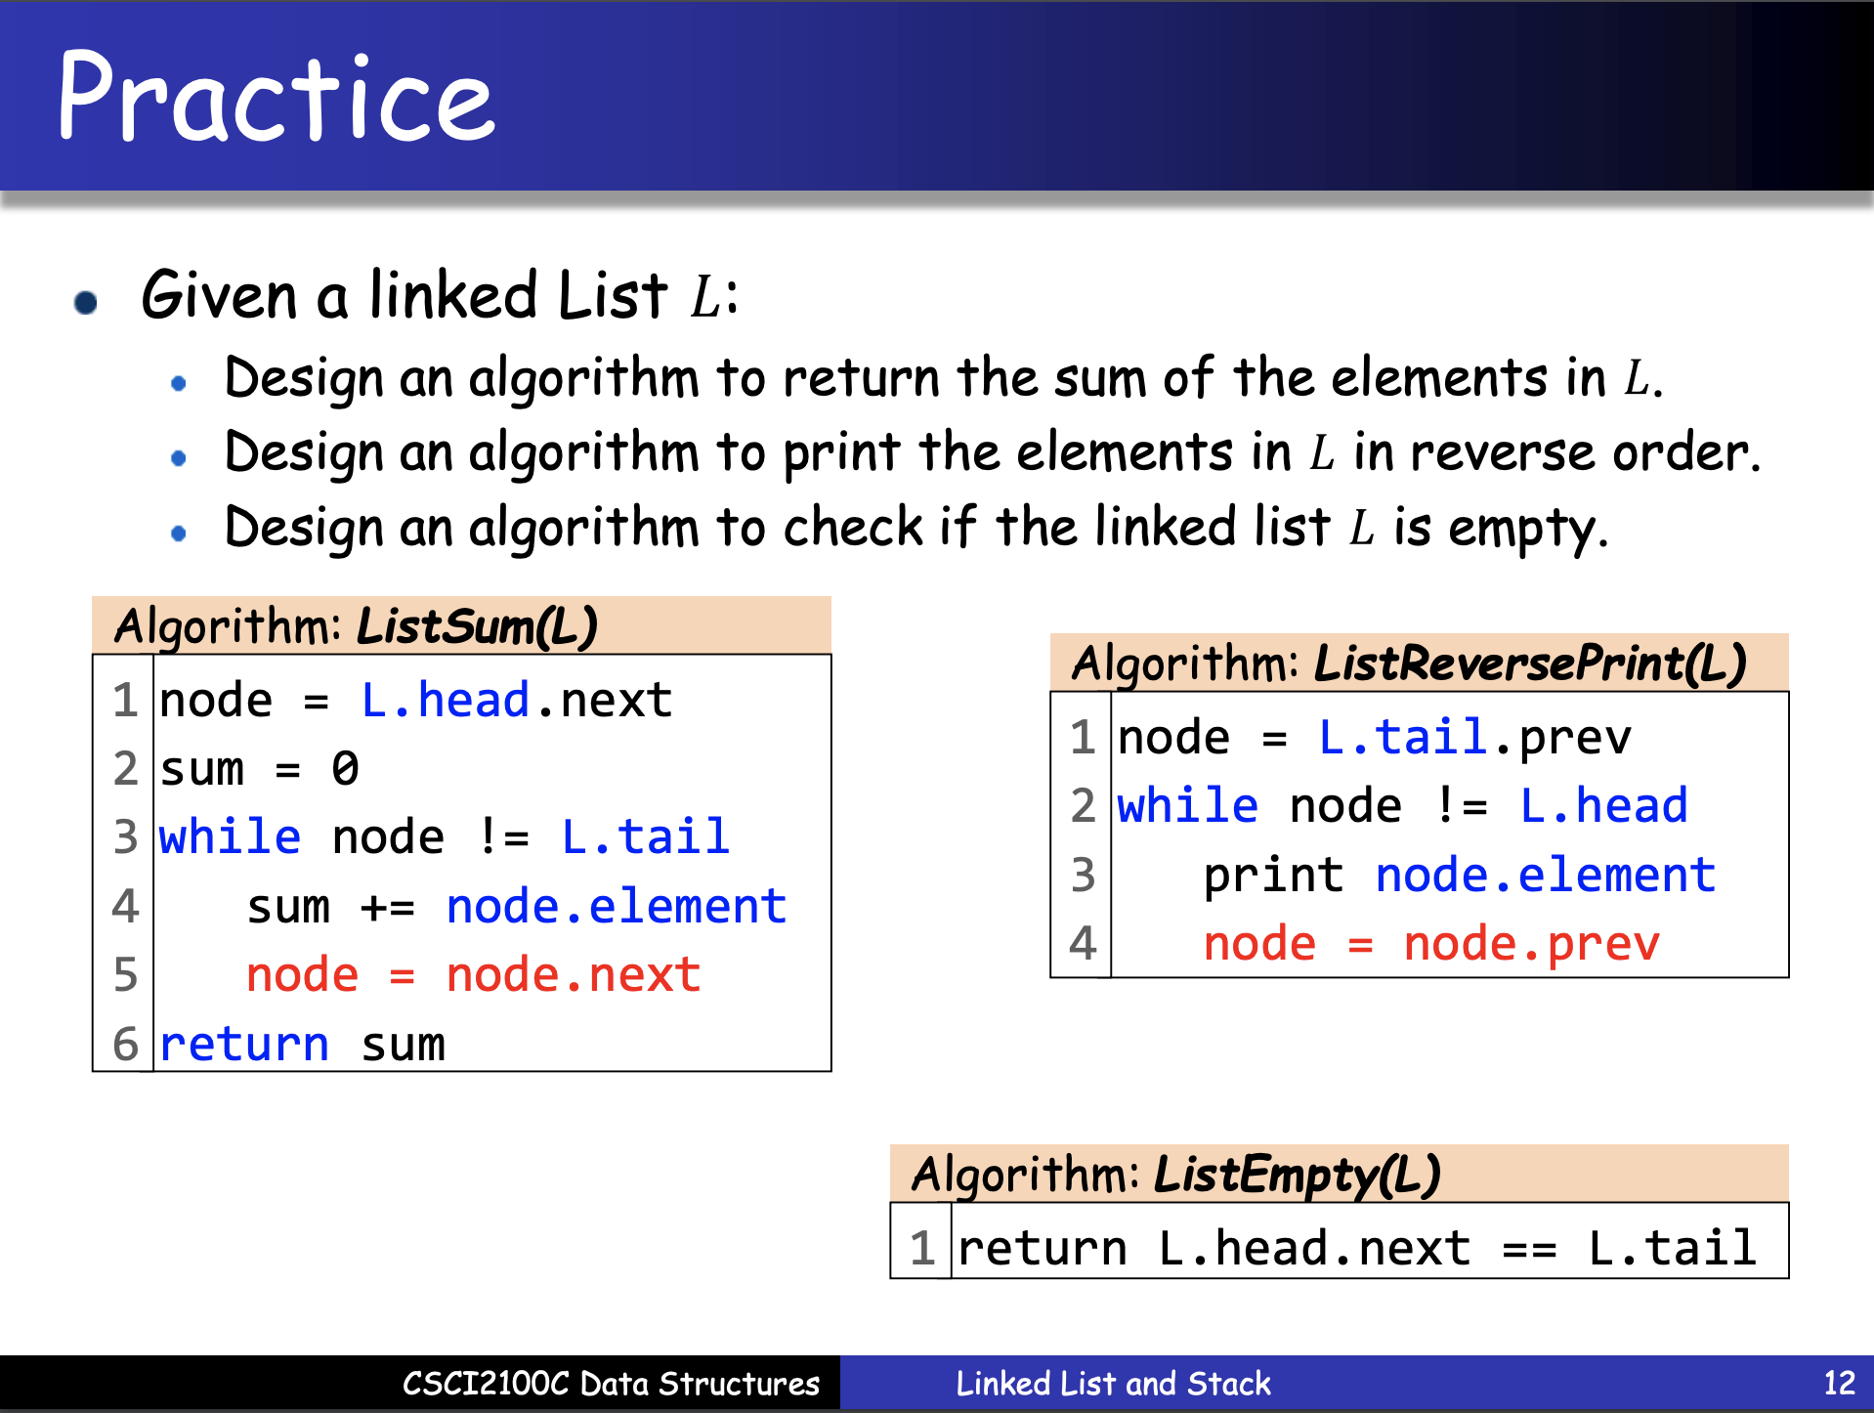
Example Code Discussion Reminder on Lecture Material
Pseudo code vs. C code
Normally we access a node in linked list by pointer
Nodes of linked list are created dynamically (at runtime) and they can only be accessed through pointer
L->head->next

Slide 23
Example Code Discussion Comparison of ListSum in Pseudo Code and C
In C, we write ListSum as:
int ListSum(List L){
PtrToNode node = L->head->next;
int sum = 1;
while (node != L->tail){
sum += node->element;
node = node->next;
}
return sum;
}
typedef struct Node * PtrToNode;
struct Node {
int element;
PtrToNode next;
PtrToNode prev;
};
typedef struct ListRecord * List;
struct ListRecord {
PtrToNode head;
PtrToNode tail;
};

Slide 24
Agenda
Array
Linked List
Stack
Queue
Example Code Discussion
Overview of Lab 2 Problems

Slide 25
Lab 2 Problem 1
Implementing Stack with Array
Description:
Given a series of stack operations, please complete the stack ADT to output for respective operations.
Input:
The first line is a positive integer N, which denotes the capacity of the stack, followed by M lines of stack operations, each chosen from one of the followings: Push x, Pop, Isfull and Isempty, except the last of which, which is End.
Output:
A line per Pop (if stack is empty), Isfull or Isempty operation, each denoting the output of the specified operation, following by a line of remaining elements in the stack from bottom to top upon End
Sample Input 1:
4
Pop
Push 1
Push 2
End
Sample Output 1:
Stack is empty
1 2
Straight forward implementation of stack with array
Key points to note:
Conditions for fullness/emptiness of stack
Code segment to complete:
Sample Input 2:
2
Isempty
Push 1
Isfull
Pop
End
Sample Output 2:
Stack is empty
Stack is not full
struct Stack {
int * arr;
int capacity;
int top;
};
int IsFull(struct Stack * stack){
// write your code here
}
int IsEmpty(struct Stack * stack){
// write your code here
}
int Push(struct Stack * stack, int x){
// write your code here
}
int Pop(struct Stack * stack){
// write your code here
}

Slide 26
Lab 2 Problem 2
Implementing Queue with Array
Description:
Given a series of queue operations, please complete the queue ADT to output for respective operations.
Input:
The first line is a positive integer N, which denotes the capacity of the queue, followed by M lines of queue operations, each chosen from one of the followings: Enqueue x, Dequeue, Isfull and Isempty, except the last of which, which is End.
Output:
A line per Dequeue (if queue is empty), Isfull or Isempty operation, each denoting the output of the specified operation, following by a line of remaining elements in the queue from head to tail upon End.
Sample Input 1:
4
Dequeue
Enqueue 1
Enqueue 2
Dequeue
End
Sample Output 1:
Queue is empty
2
Key points to note:
How to make sure the queue is sustainable (no “crawling”)?
Condition of fullness/emptiness of queue?
Code segment to complete:
Sample Input 2:
2
Isempty
Enqueue 1
Isfull
End
Sample Output 2:
Queue is empty
Queue is full
1
struct Queue {
int * arr;
int capacity;
int front;
int rear;
};
int IsFull(struct Queue * queue){
// write your code here
}
int IsEmpty(struct Queue * queue){
// write your code here
}
int Enqueue(struct Queue * queue, int x){
// write your code here
}
int Dequeue(struct Queue * queue){
// write your code here
}

Slide 27
Lab 2 Problem 3
Implementing Stack with Linked List
Description:
Given a series of stack operations, please complete the stack ADT to output for respective operations.
Input:
M lines of stack operations, each chosen from one of the followings: Push x and Pop, except the last of which, which is End.
Output
A line per Pop (if stack is empty) operation, denoting the stack is empty, following by a line of remaining elements in the stack from bottom to top upon End
Sample Input 1:
Pop
Push 1
Push 2
End
Sample Output 1:
Stack is empty
1 2
Key points to note:
Condition for emptiness of stack?
Best practice to remove the element during pop?
Sample Input 2:
Pop
Push 1
End
Sample Output 2:
Stack is empty
1
Code segment to complete:
typedef struct Node * PtrToNode;
struct Node {
int element;
PtrToNode next;
PtrToNode prev;
};
typedef struct ListRecord * List;
struct ListRecord {
PtrToNode head;
PtrToNode tail;
};
void Insertion(int x, List L){
// write your code here
}
int Deletion(List L){
// write your code here
}

Slide 28
Lab 2 Problem 4
Implementing Queue with Linked List
Description:
Given a series of queue operations, please complete the queue ADT to output for respective operations.
Input:
M lines of queue operations, each chosen from one of the followings: Enqueue x and Dequeue, except the last of which, which is End.
Output:
A line per Dequeue (if queue is empty) operation, denoting the queue is empty, following by a line of remaining elements in the queue from head to tail upon End
Sample Input 1:
Dequeue
Enqueue 1
Enqueue 2
Dequeue
End
Sample Output 1:
Queue is empty
2
Key points to note:
Condition for emptiness of queue?
Best practice to remove the element during dequeue?
Sample Input 2:
Dequeue
Enqueue 1
Dequeue
End
Sample Output 2:
Queue is empty
Code segment to complete:
typedef struct Node * PtrToNode;
struct Node {
int element;
PtrToNode next;
PtrToNode prev;
};
typedef struct ListRecord * List;
struct ListRecord {
PtrToNode head;
PtrToNode tail;
};
void Insertion(int x, List L){
// write your code here
}
int Deletion(List L){
// write your code here
}

Slide 29
Last but not Least
Please add this declaration on top of (commented as shown) all your codes submitted to the OJ.
/*
I, <Your Full Name>, am submitting the assignment for
an individual project.
I declare that the assignment here submitted is original except for
source material explicitly acknowledged, the piece of work, or a part
of the piece of work has not been submitted for more than one purpose
(i.e. to satisfy the requirements in two different courses) without
declaration. I also acknowledge that I am aware of University policy
and regulations on honesty in academic work, and of the disciplinary
guidelines and procedures applicable to breaches of such policy and
regulations, as contained in the University website
http://www.cuhk.edu.hk/policy/academichonesty/.
It is also understood that assignments without a properly signed
declaration by the student concerned will not be graded by the
teacher(s).
*/

Slide 30
Reminders
Please remember your password for the online judge
Please start your assignment early
And report any issues as early as possible. Some issues regarding the registration of the OJ were reported not until some hours before the deadline. For such cases of failure of code submission, we may not grade your lab.
Penalty:
-10 marks/day pro rata for first two days after deadline
-10 marks/hour pro rata afterwards (so you get 0 marks if you submit 2 day 8 hours after the deadline)
Grading is based on the last submission
Write your own code
We will check your code
Suspected cases of plagiarism will be reported
Questions?

Slide 31
Questions?

